Slide 1
Conversation to Automation in Banking Through Chatbot Using Artificial Machine Intelligence Language

Slide 2
Presented By:
Team Members:
R.Vamsi Kumar Reddy 21BJ1A54B1
G.Ajay 21BJ1A5420
D.Sai Teja 21BJ1A5412
SK.Hidayathullah 21BJ1A5457
Guide: Dr.SSN Anjaneyulu,M.Tech
Associate Professor.

Slide 3
Index
1. Abstract
2. Introduction
3. Literature Survey
4. Existing Methodology
5.Technologies used
6. Proposed Methodology with Architecture
7.Performance
8. Results
9. Conclusion
10. References

Slide 4
Abstract
The project focuses on a chatbot system for banking, enabling
users to interact seamlessly and securely with banking services.
It aims to provide 24/7 customer support, handle queries, and
reduce human workload using Natural Language Processing
(NLP) and machine learning techniques.

Slide 5
Introduction
Chatbots are AI driven virtual Assistants designed to simulate
conversations.
The integration of AI in banking has transformed customer
service.
This chatbot system is designed to manage customer
queries efficiently, enabling real-time responses and enhancing
the overall user experience.
It leverages Django and Python for backend functionalities.

Slide 6
Literature Survey
Research on AI-powered chatbots in customer service.
NLP algorithms and their role in user interaction.
Case studies of chatbot implementations in banking sectors.
Comparisons between different chatbot platforms.

Slide 7
Existing Methodology
Traditional banking systems rely heavily on human resources for customer service.
Existing chatbot systems are often limited in functionality and struggle to understand complex queries or offer personalized responses.

Slide 8
Proposed Methodology
The system is developed using Django (Python web frame work).
It integrates a chatbot interface with backend NLP logic.
Chat inputs are processed and responses fetched from a trained model or predefined logic.
Includes user authentication, secure transaction querying, and FAQ support

Slide 9
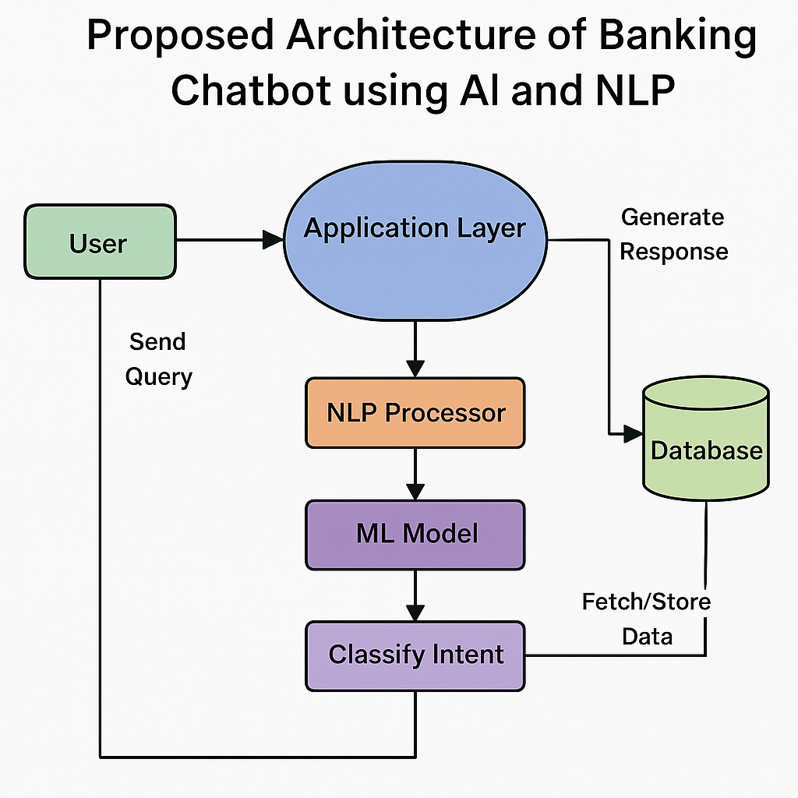
Proposed Methodology Architecture

Slide 10
Technologies Used
Django: Python web framework used to build the backend,
handle routing, and connect chatbot logic with machine learning models.
Natural Language Processing (NLP): Used to understand user queries
through tokenization, lemmatization, and intent recognition (using
NLTK).
Machine Learning: Implements algorithms like Random Forest, SVM,
and KNN to classify user intent and generate responses (via Scikit-learn).
XAMPP & MySQL: XAMPP provides a local server environment;
MySQL stores user data, chatbot responses, and logs.

Slide 11
Performance
1. KNN achieved an accuracy of 95.46%.
2.Random Forest achieved an accuracy of 99.43%.
3.SVM achieved an accuracy of 97.73%.

Slide 12
Results
1. Improved response time to user queries.
2. Reduced dependency on human agents.
3. Enhanced customer satisfaction through 24/7 availability.
4. Easy integration with existing banking platforms.

Slide 13
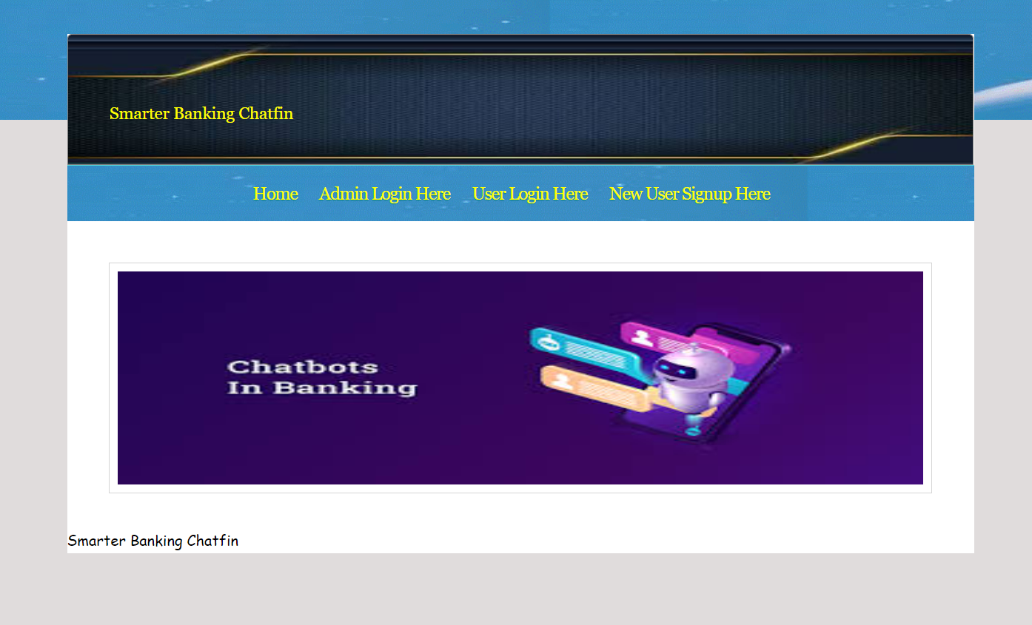
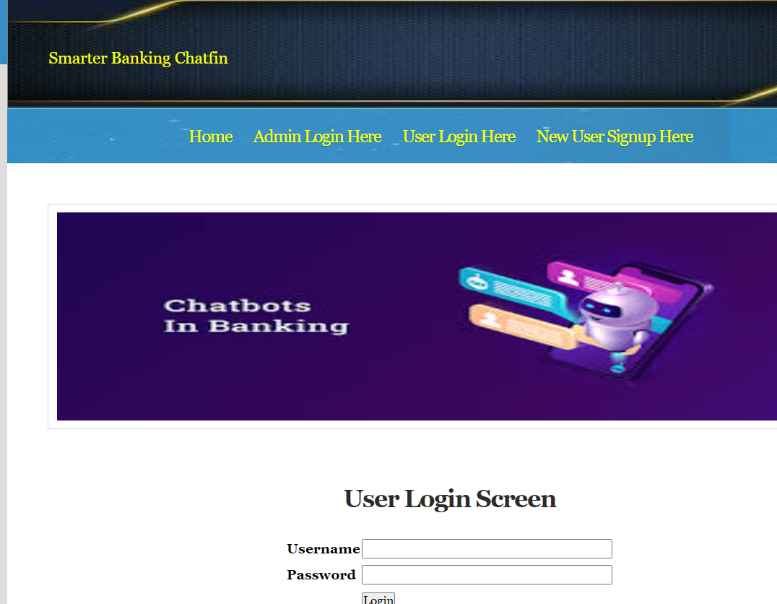
Screen Shots of Output

Slide 14
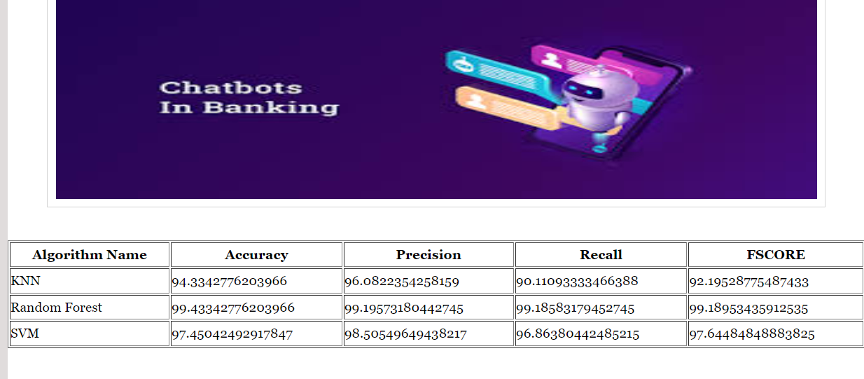
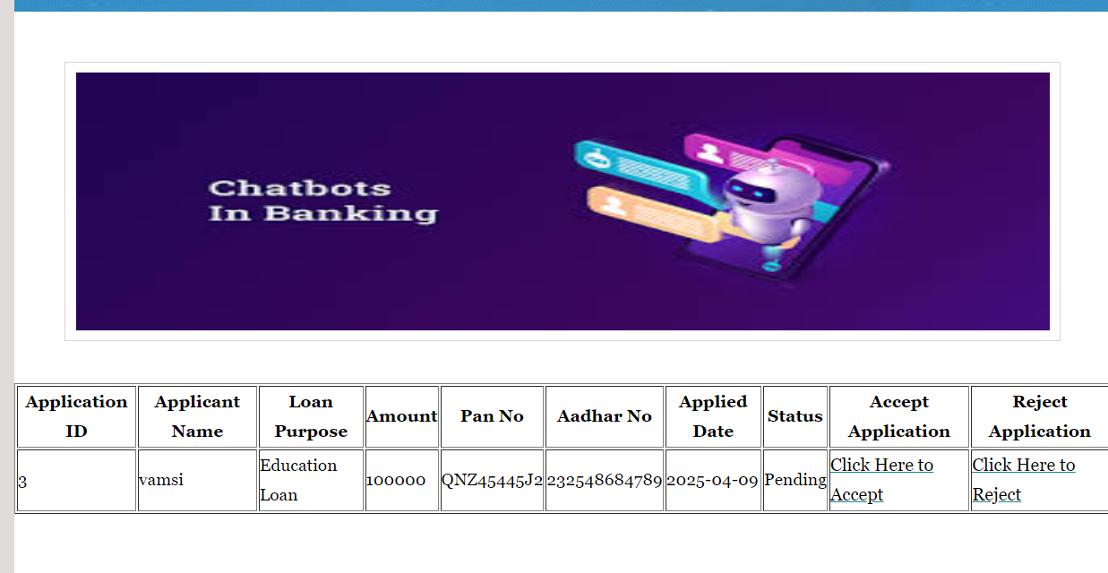

Slide 15
Conclusion
Developed an AI-powered banking chatbot usingDjango, NLP, and Machine Learning
Implemented Random Forest, SVM, and KNN algorithms for accurate intent classification and response generation
Enabled 24x7 automated customer support, reducing human workload and improving response time
Used XAMPP and MySQL for secure data storage and seamless backend integration
Delivers a scalable, smart, and user-friendly solution for modern digital banking services

Slide 16
THANK YOU

